Slide 1

Support Vector Machine
KIET Group of Institutions

Slide 2
Support Vector Machine
SVM is a supervised algorithm which can be used for both classification or regression problems. It separates data by using concept of hyperplanes.
It is used to generate multiple separating hyperplanes such that the data space is divided into segments and each segment contains only one kind of data.
It is generally useful for data which has non-regularity i.e. data whose distribution is unknown.

Slide 3
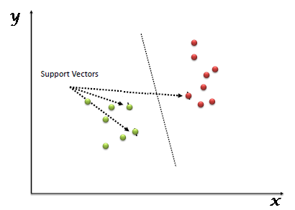
Support Vector Machine
Support Vectors are simply the co-ordinates of individual observation. These are data points that are closer to the hyperplane and influence the position and orientation of the hyperplane.

Slide 4
Support Vector Machine
.
SVM takes the training data as an input and outputs a line/hyperplane that separates those classes if possible.
For a space of n dimensions, we have a hyperplane of n-1 dimensions separating it into two or more parts.

Slide 5
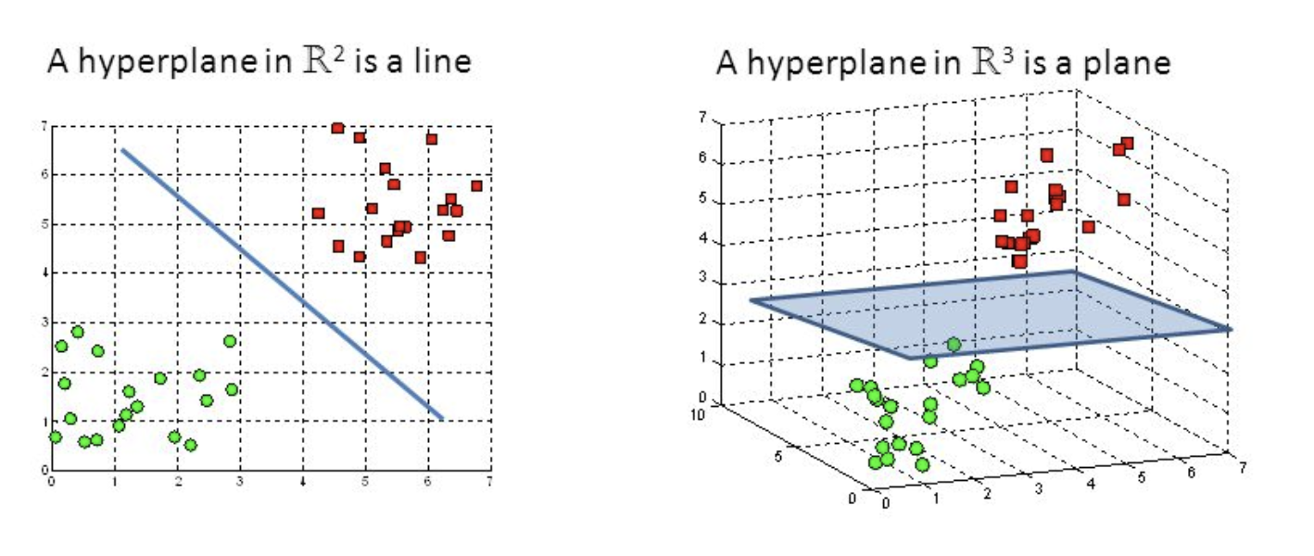
Support Vector Machine

Slide 6
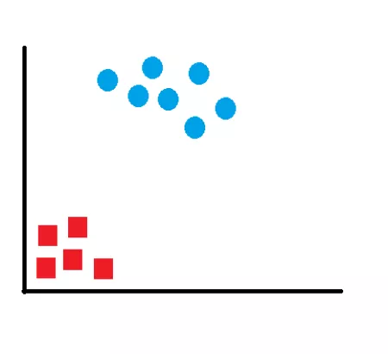
Support Vector Machine

Slide 7
Support Vector Machine
This data is simple to classify and one can see that the data is clearly separated into two segments.
Any line that separates the red and blue items can be used to classify the above data.

Slide 8
Support Vector Machine
Had this data been multi-dimensional data, any plane can separate and successfully classify the data.
However, we want to find the “most optimal” solution. What will then be the characteristic of this most optimal line?

Slide 9
Support Vector Machine
We have to remember that this is just the training data and we can have more data points which can lie anywhere in the subspace. If our line is too close to any of the data points, noisy test data is more likely to get classified in a wrong segment.
We have to choose the line which lies between these groups and is at the farthest distance from each of the segments.

Slide 10
Support Vector Machine
To solve this classifier line, we draw the line as y=ax+b and make it equidistant from the respective data points closest to the line. So we want to maximize the margin (m).

Slide 11
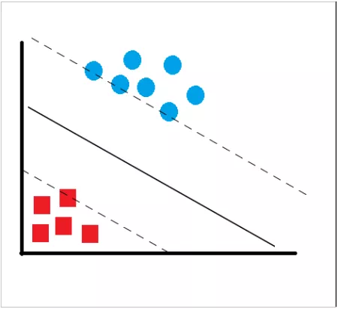
Support Vector Machine

Slide 12
Support Vector Machine
How does it work?
The process of segregating the two classes with a hyper-plane.
“How can we identify the right hyper-plane?”.

Slide 13
Support Vector Machine
Identify the right hyper-plane (Scenario-1): Here, we have three hyper-planes (A, B and C). Now, identify the right hyper-plane to classify star and circle.

Slide 14
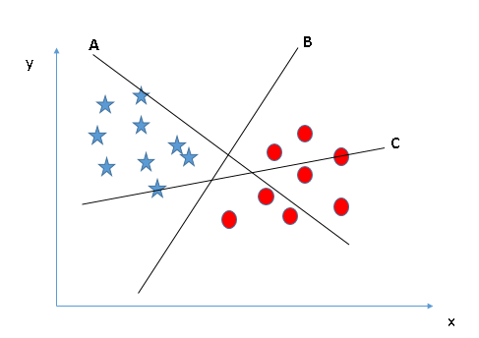
Support Vector Machine

Slide 15
Support Vector Machine
Identify the right hyper-plane (Scenario-2): Here, we have three hyper-planes (A, B and C) and all are segregating the classes well. Now, How can we identify the right hyper-plane?

Slide 16
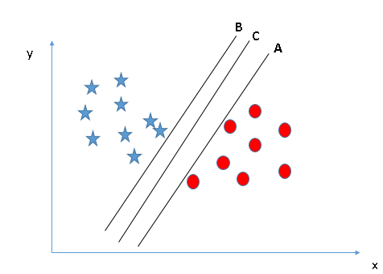
Support Vector Machine

Slide 17
Support Vector Machine
Here, maximizing the distances between nearest data point (either class) and hyper-plane will help us to decide the right hyper-plane. This distance is called as Margin. Let’s look at the below snapshot:

Slide 18
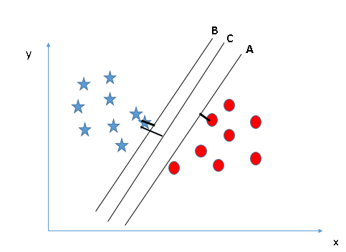
Support Vector Machine

Slide 19
Support Vector Machine
You can see that the margin for hyper-plane C is high as compared to both A and B. Hence, we name the hyper-plane C as best.
Another lightning reason for selecting the hyper-plane with higher margin is robustness. If we select a hyper-plane having low margin then there is high chance of miss-classification.

Slide 20
Support Vector Machine
Identify the right hyper-plane (Scenario-3):Hint: Use the rules as discussed in previous section to identify the right hyper-plane

Slide 21
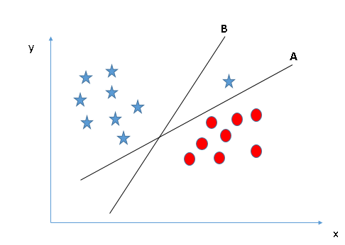
Support Vector Machine

Slide 22
Support Vector Machine
Some of you may have selected the hyper-plane B as it has higher margin compared to A. But, here is the catch, SVM selects the hyper-plane which classifies the classes accurately prior to maximizing margin. Here, hyper-plane B has a classification error and A has classified all correctly. Therefore, the right hyper-plane is A.

Slide 23
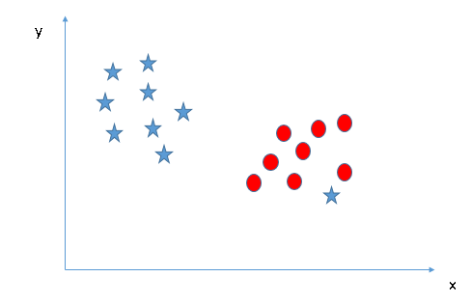
Support Vector Machine

Slide 24
Support Vector Machine
One star at other end is like an outlier for star class. SVM has a feature to ignore outliers and find the hyper-plane that has maximum margin. Hence, we can say, SVM is robust to outliers.

Slide 25
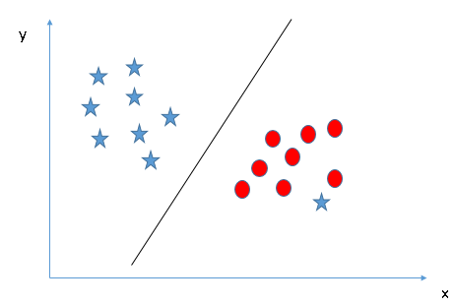
Support Vector Machine

Slide 26
Support Vector Machine
Find the hyper-plane to segregate to classes (Scenario-5): In this scenario, we can’t have linear hyper-plane between the two classes, so how does SVM classify these two classes? (Till now, we have only looked at the linear hyper-plane)

Slide 27
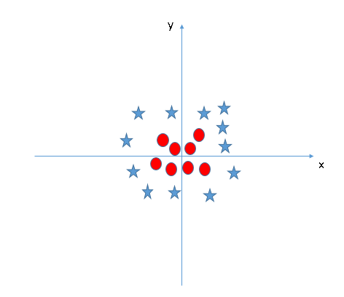
Support Vector Machine

Slide 28
Support Vector Machine
SVM can solve this problem. Easily! It solves this problem by introducing additional feature. Here, we will add a new feature z=x^2+y^2. Now, let’s plot the data points on axis x and z

Slide 29
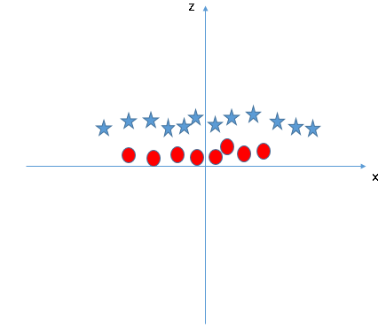
Support Vector Machine

Slide 30
Support Vector Machine
In this plot, points to be considered are:
All values for z would be positive always because z is the squared sum of both x and y.
In the original plot, red circles appear close to the origin of x and y axes, leading to lower value of z and star relatively away from the origin result to higher value of z.

Slide 31
Support Vector Machine
SVM, the function which converts non-separable problem to separable problem, is called kernel.
It is mostly useful in non-linear separation problem.
It does some extremely complex data transformations to separate the data based on the labels or outputs.

